Slide 1


Atliq Hardware's
Consumer Goods ‘Ad-hoc- insights
Presented By
Swathi G

Slide 2
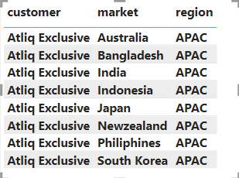
Request 1
Provide the list of markets in which customer “Atliq Exclusive” operates its business in the APAC region.

Slide 3
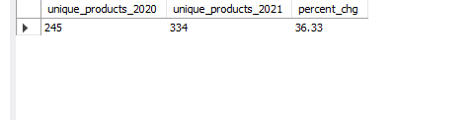
Request 2
What is the percentage of unique product increase in 2021 vs. 2020?

Slide 4
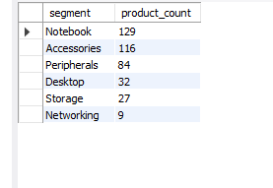
Request 3
Provide a report with all the unique product counts for each segment and sort them in descending order of product counts.
Output

Slide 5
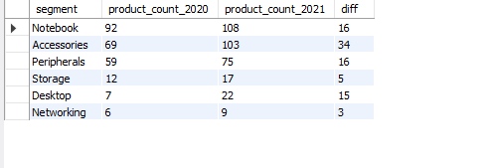
Request 4
Follow-up: Which segment had the most increase in unique products in 2021 vs 2020? The final output contains these fields,
Out Put

Slide 6

Request 5
Get the products that have the highest and lowest manufacturing costs.
Output

Slide 7
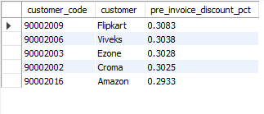
Request 6
Generate a report which contains the top 5 customers who received an average high pre_invoice_discount_pct for the fiscal year 2021 and in the Indian market.
Out put

Slide 8
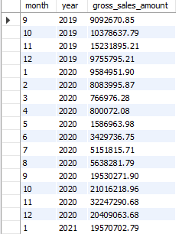
Request 7
Get the complete report of the Gross sales amount for the customer “Atliq Exclusive” for each month. This analysis helps to get an idea of low and high-performing months and take strategic decisions.
Output

Slide 9

Request 8
In which quarter of 2020, got the maximum total_sold_quantity?
Output

Slide 10

Request 9
Which channel helped to bring more gross sales in the fiscal year 2021 and the percentage of contribution?
Output

Slide 11
Thank You
Swathi G

